Slide 1
Concept of Anti-patterns

Slide 2
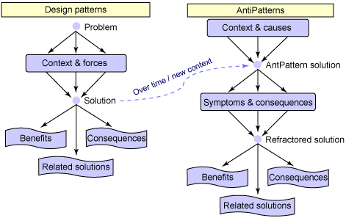

Slide 3


Slide 4
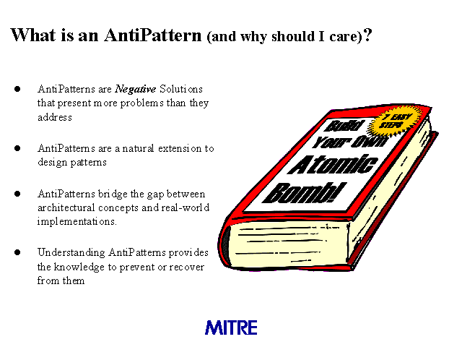

Slide 5
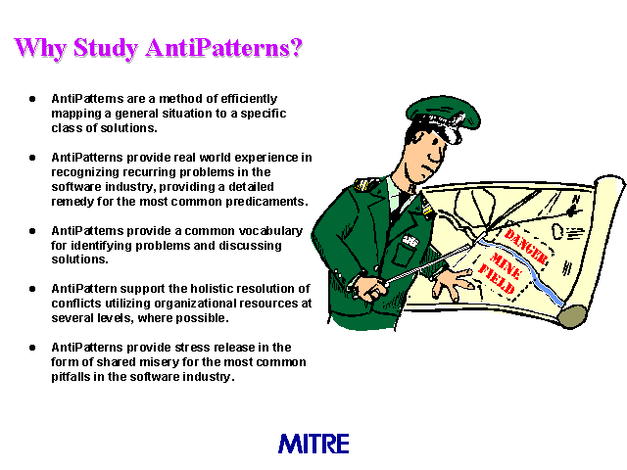

Slide 6
AntiPatterns, like their design pattern counterparts, define an industry vocabulary for the common defective processes and implementations within organizations
A higher-level vocabulary simplifies communication between software practitioners and enables concise description of higher-level concepts
Describes a commonly occurring solution to a problem that generates decidedly negative consequences
The AntiPattern may be the result of a manager or developer not knowing any better, not having sufficient knowledge or experience in solving a particular type of problem, or having applied a perfectly good pattern in the wrong context

Slide 7
Recognizing recurring problems in the software industry
Provide a detailed remedy for the most common predicaments
Highlight the most common problems that face the software industry and provide the tools to enable you to recognize these problems and to determine their underlying causes
Implementing productive solutions
Improve the developing of applications, the designing of software systems
Effective management of software projects

Slide 8


Software Development AntiPatterns
A key goal of development AntiPatterns is to describe useful forms of software refactoring
Software refactoring is a form of code modification, used to improve the software structure in support of subsequent extension and long-term maintenance
Software Architecture AntiPatterns
Architecture AntiPatterns focus on the system-level and enterprise-level structure of applications and components

Slide 9

Project Management AntiPatterns
In the modern engineering profession, more than half of the job involves human communication and resolving people issues
The management AntiPatterns identify some of the key scenarios in which these issues are destructive to software processes

